Slide 1


A Search for Standard Model Higgs Boson Production in Association with Top-Quark Pairs
At CMS Dissertation Defense, April 22nd, 2015
Charlottesville, Virginia
John Wood
University of Virginia
CMS Collaboration

Slide 2

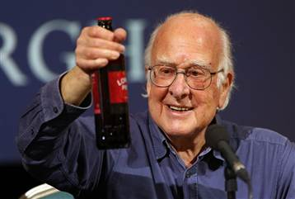


Higgs Discovery at the LHC
John Wood – jgw2kb@virginia.edu – University of Virginia

Slide 3
Latest Higgs Results
Newly Discovered Boson
Mass of ~125 GeV, consistent with precision EWK measurements
Spin 0, positive parity, consistent with SM Higgs predicted properties
Coupling to SM leptons and bosons, consistent with SM Higgs predicted properties
Significant progress has been made towards the characterization of this new particle, but have yet to measure the coupling to the top-quark
CMS Public Results
CMS Public Results
CMS Public Results
John Wood – jgw2kb@virginia.edu – University of Virginia

Slide 4
Higgs Production at the LHC
John Wood – jgw2kb@virginia.edu – University of Virginia

Slide 5
Top-Higgs Interplay
Top quark is essential for characterizing the new, recently observed boson
If it is the SM Higgs: need to see coupling to all fermions
Large top-quark mass means large coupling to SM Higgs
ttH: best production mode directly sensitive to top-Higgs Yukawa coupling
Gluon-Gluon fusion: triangle loop to produce Higgs has contributions for other SM and potentially BSM particles
John Wood – jgw2kb@virginia.edu – University of Virginia

Slide 6
Direct Search for ttH
Virtues
Access to all Higgs decay modes
bb was the obvious place to start
WW, ZZ, ττ, γγ are additional possibilities
Top quarks have distinctive, characteristic signature
Focus initially on final states where one or both top-quarks decay leptonically
John Wood – jgw2kb@virginia.edu – University of Virginia

Slide 7
Direct Search for ttH
Virtues
Access to all Higgs decay modes
bb was the obvious place to start
WW, ZZ, ττ, γγ are additional possibilities
Top quarks have distinctive, characteristic signature
Focus initially on final states where one or both top-quarks decay leptonically
Challenges
Low production cross section
Signal phase space suffers low statistics
Swamped with tt+jets background
tt+bb difficult to discriminate
Irreducible, poorly known
Very busy events
Recoil of ttbar system against Higgs
Final state is more complex than typical tt+jets system + typical Higgs system
John Wood – jgw2kb@virginia.edu – University of Virginia

Slide 8
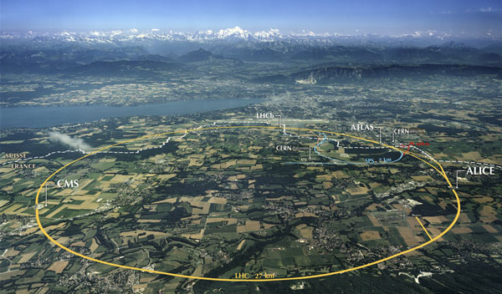
LHC Overview
John Wood – jgw2kb@virginia.edu – University of Virginia

Slide 9
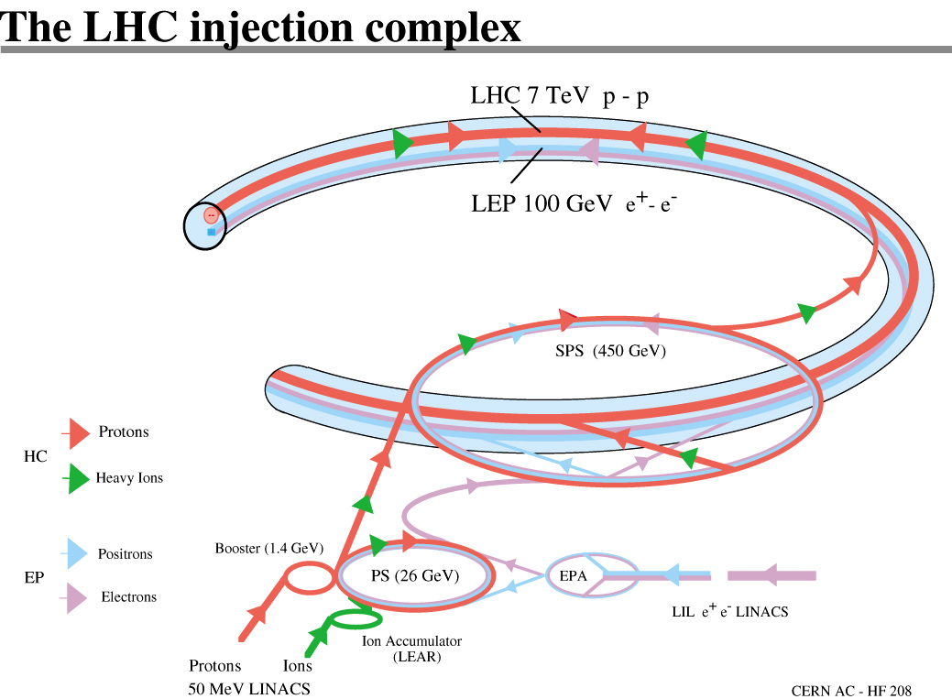
LHC Overview
John Wood – jgw2kb@virginia.edu – University of Virginia

Slide 10
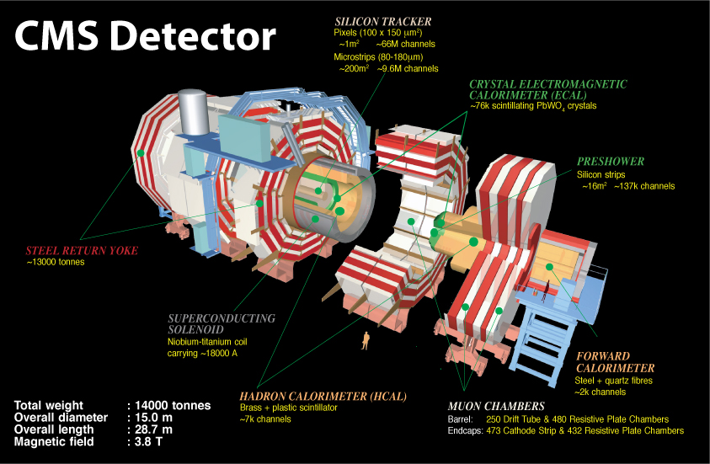
CMS Detector Overview
John Wood – jgw2kb@virginia.edu – University of Virginia

Slide 11
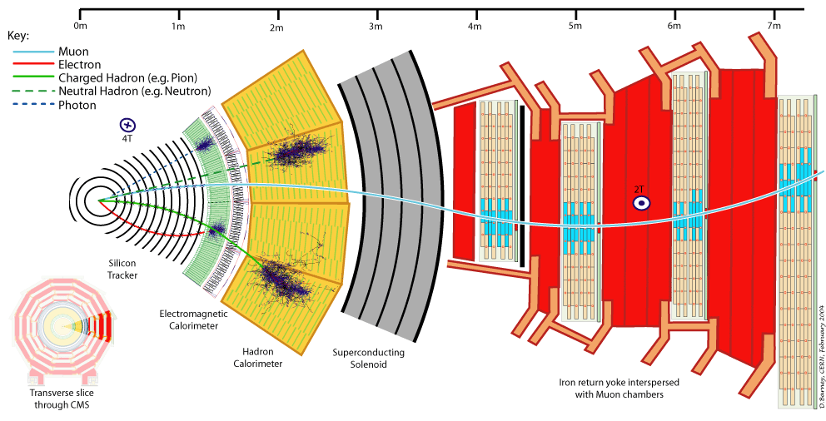
CMS Detector Overview
John Wood – jgw2kb@virginia.edu – University of Virginia

Slide 12
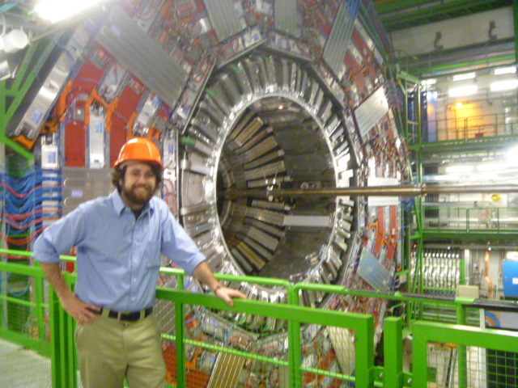
CMS Detector Overview
John Wood – jgw2kb@virginia.edu – University of Virginia

Slide 13
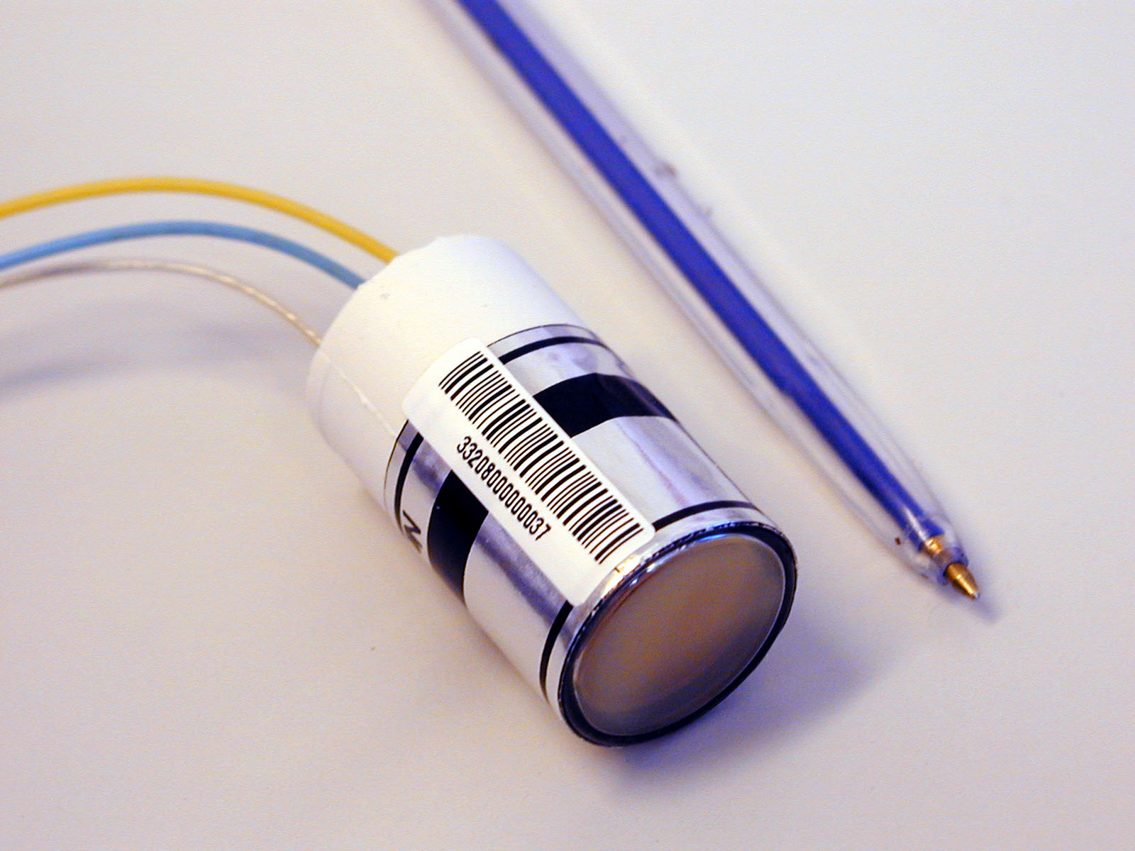
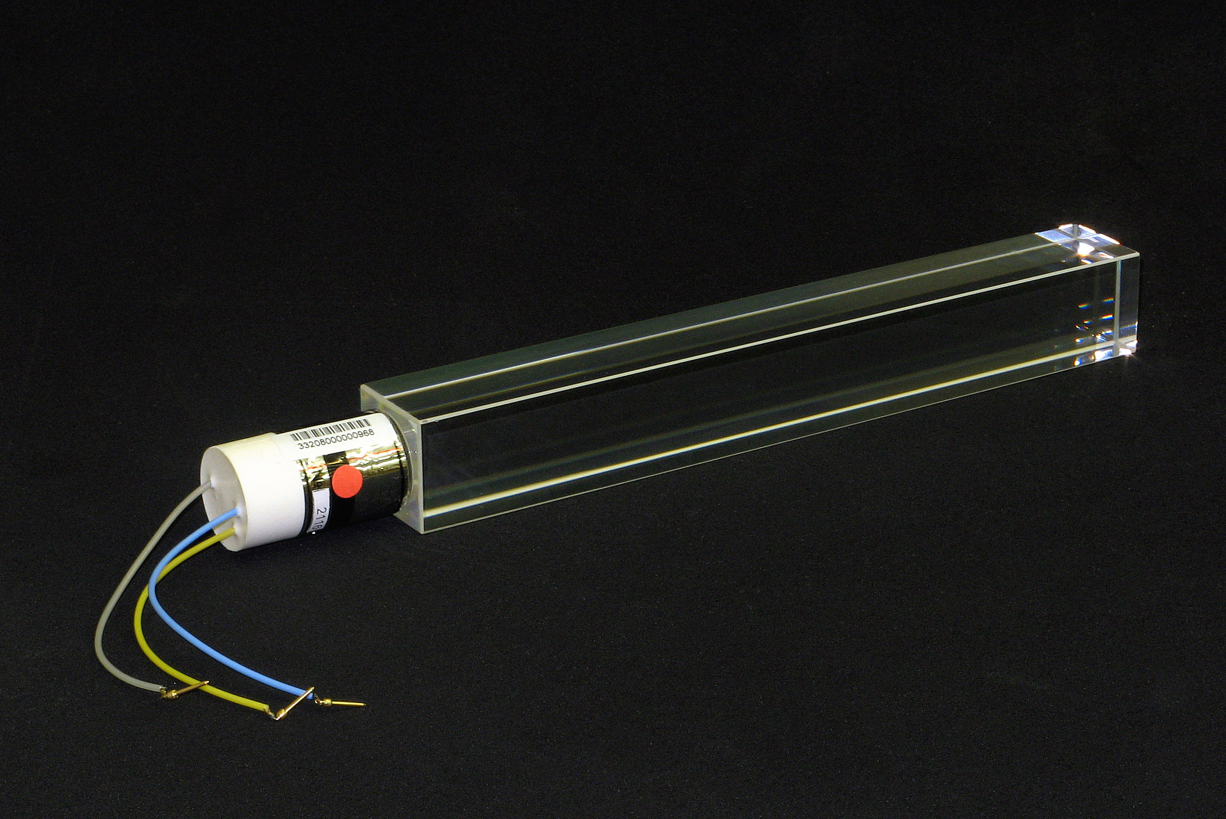
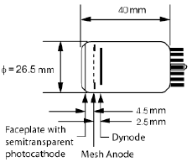
Vacuum Photo-Triodes (VPTs) and the ECAL Endcap
Vacuum Photo-Triode – single stage photomultiplier device, adhered to back of lead tungstate crystals – measures scintillation light
Cesium cathode for photoelectron production
Anode is a mesh grid, captures ~50% of photo-electrons passing through it, 800V
Dynode is behind anode, 600V, pushes electrons back towards anode for collection
John Wood, University of Virginia jgw2kb@virginia.edu

Slide 14
ECAL related sidebar - VPT Test Stand - Description
VPTs perform well in magnetic fields, and are radiation hard – great for ECAL endcap environment
Over time VPT anode response decreases, described well by a function of two exponentials with different time constants, modeling the two primary effects of VPT aging
Ion damage to cathode due to loss of vacuum and large electric potentials
Depletion of photo-electrons from the cathode
In-situ at CMS, this effect is convoluted with light loss of crystals from radiation damage – necessary to study VPT lifetime performance effects independently
University of Virginia HEP has access to a large-bore 3.8T solenoid magnet
Cryogen cooled – required LN_{2,} LHe fills once a week, and month respectively
Test-stand – 5 VPTs tested at a time
PIN diodes used as a control for measuring LED source light, signal amplification in housing next to VPTs to prevent noise pickup on small signal output
Three LEDs are used to pulse VPTs
Blue Load LED – simulates beam cycle and light exposure from crystal
Blue & Orange Reference LEDs – measurement LEDs for VPT performance
Load light illumination and measurement cycle continue for ~3-4 months per run
6 runs completed at UVa
John Wood, University of Virginia jgw2kb@virginia.edu

Slide 15
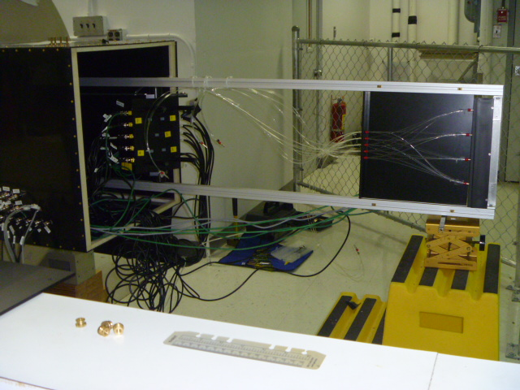
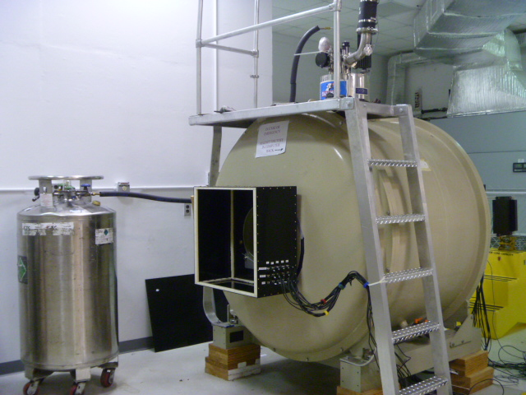
Magnet and Test Stand
Below:
3.8T superconducting solenoid magnet
Inner bore houses VPTs and amplifier equipment
VPT housing
Fiber optics
Magnet maintenance
access
Amplifier
Led pulsing card
Cryogenic Cooling
Above:
VPT, amplifier housing, fiber optics, and LED pulsing card, mounted on test stand railing system
In picture – maintenance position, outside of bore
Rig Breakout Panel
John Wood, University of Virginia jgw2kb@virginia.edu

Slide 16
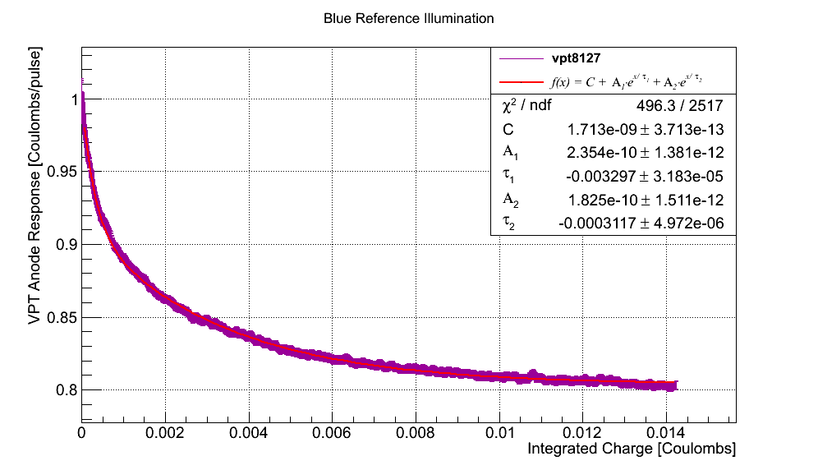
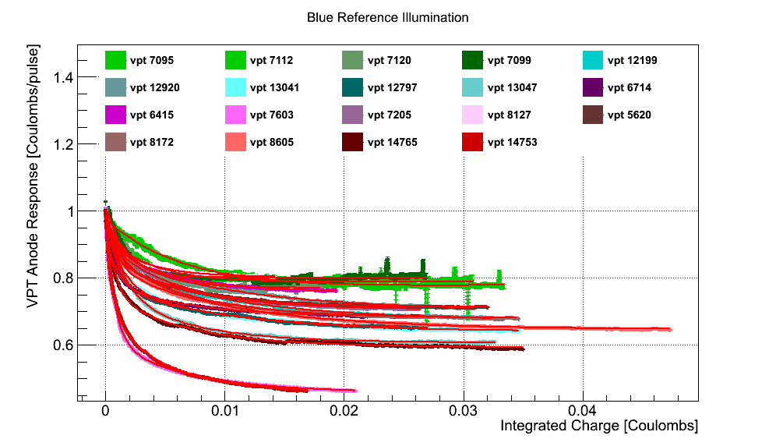
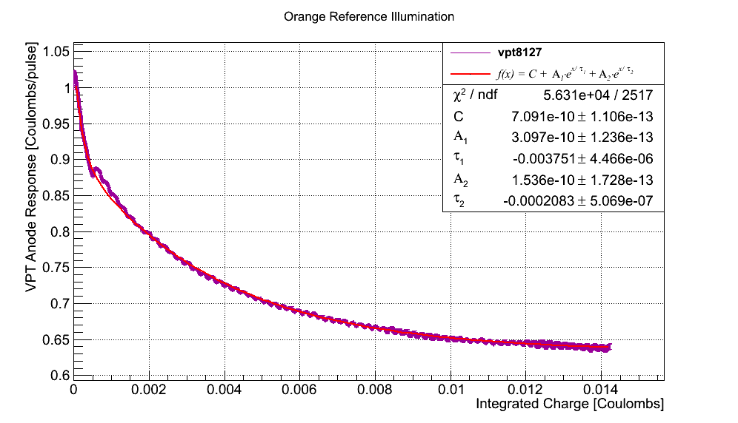
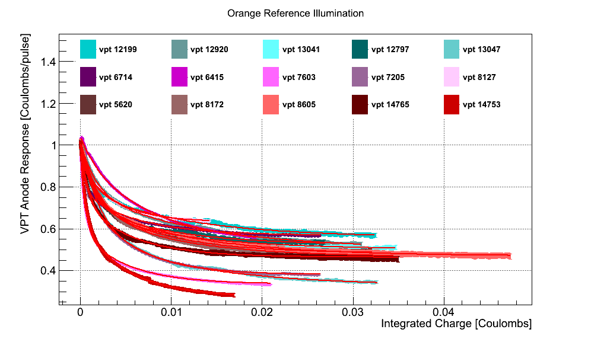
Blue and Orange Reference LED – Fits Summary
NIM paper expected to be published later this year from these results
John Wood, University of Virginia jgw2kb@virginia.edu

Slide 17
ttH Signature
b quark from top
quarks from hadronic W
b quarks from Higgs
Lepton and MET from W
anti-b quark from anti-top
John Wood – jgw2kb@virginia.edu – University of Virginia

Slide 18
Event Selection
8TeV Data - 2012, 5.1 fb⁻¹
Start from tt-enriched sample:
Event passes single muon/electron+jets trigger
1 isolated lepton (30 GeV)
At least 3 jets (40GeV) plus 1 jet (30GeV)
At least 2 b-tagged jets (CSVM)
Categorize events into bins of nJets and nTags
Signal will occupy higher jet/tag multiplicity bins
Background will occupy lower bins
Jet 4
Jet 7
Jet 1
Jet 6
Jet 2
Jet 3
MET
Jet 5
Muon
John Wood – jgw2kb@virginia.edu – University of Virginia

Slide 19
Number of Jets/Tags Distributions
John Wood – jgw2kb@virginia.edu – University of Virginia

Slide 20
Categorization by Number of Jets/Tags
S/Sqrt(B) for each jet/tag category
Highlighted green region is signal-enriched
Lepton+Jets, 7 categories:
4 jets (3, ≥ 4 tags)
5 jets (3, ≥ 4 tags)
>=6 jets (2, 3, ≥ 4 tags)
Number of Jets
 | 4 | 5 | >=6
2 | - | - | 0.19
3 | 0.10 | 0.20 | 0.27
>=4 | 0.13 | 0.23 | 0.31
Number of Tags
John Wood – jgw2kb@virginia.edu – University of Virginia

Slide 21
Background Processes
ttbar – top-quark pair production, with extra jets coming from ISR/FSR or higher-order processes
John Wood – jgw2kb@virginia.edu – University of Virginia

Slide 22
Background Processes
ttbar – top-quark pair production, with extra jets coming from ISR/FSR or higher-order processes
ttbar+V – top-quark pair-production, with an additional W/Z boson
John Wood – jgw2kb@virginia.edu – University of Virginia

Slide 23
Background Processes
ttbar – top-quark pair production, with extra jets coming from ISR/FSR or higher-order processes
ttbar+V – top-quark pair-production, with an additional W/Z boson
Single t – top quark produced in association of extra jets, or W boson
John Wood – jgw2kb@virginia.edu – University of Virginia

Slide 24
Background Processes
ttbar – top-quark pair production, with extra jets coming from ISR/FSR or higher-order processes
ttbar+V – top-quark pair-production, with an additional W/Z boson
Single t – top quark produced in association of extra jets, or W boson
V+Jets – EWK production of W/Z bosons with extra jets
John Wood – jgw2kb@virginia.edu – University of Virginia

Slide 25
Background Processes
ttbar – top-quark pair production, with extra jets coming from ISR/FSR or higher-order processes
ttbar+V – top-quark pair-production, with an additional W/Z boson
Single t – top quark produced in association of extra jets, or W boson
V+Jets – EWK production of W/Z bosons with extra jets
diBoson – EWK production of WW/WZ/ZZ pairs
John Wood – jgw2kb@virginia.edu – University of Virginia

Slide 26
Background Processes
Biggest Challenges
Overwehelmingly large background contributions from tt+jets
tt+bb background, since if resembles our signal very closely
Large number of objects in event also make it difficult to distinguish which jet came from which decay, ie finding the two bTagged jets associated with Higgs
Attempts to form invariant mass of of Higgs from two bTagged jets gets smeared out from combinatorics
Signal:
ttH, H->bb
Most difficult
background: tt+bb
John Wood – jgw2kb@virginia.edu – University of Virginia

Slide 27
Searching for Discriminating Variables
High Jet multiplicity gives many possible combinations to form the invariant mass of the Higgs system, smears mass resolution
no single variable with excellent discrimination against background
Signal normalized to sum of bkg
>=6Jets,
==3Tags
==5Jets,
>=4Tags
>=6Jets,
>=4Tags
John Wood – jgw2kb@virginia.edu – University of Virginia

Slide 28
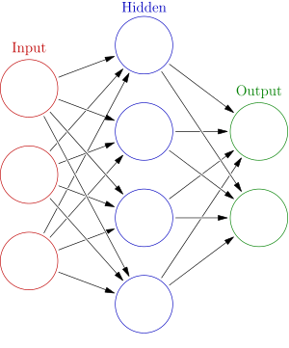
Multi-Variate Analysis Techniques
Artificial Neural Network (ANN) – specific implementation of an MVA.
The values of the input variables are assigned to a “node”
Nodes are independent functions that map an input value onto an output value, which is determined by an Activation Function – a weighted response to the input value, also known as the Synapse Response
Nodes are arranged in layers, and each node in a layer only connects to the nodes in the layer in front of it, this is known as a Multi-Layer Perceptron
Training events are given to the ANN from a known signal and background source, ANN output is compared to desired result (0=background, 1=signal) and adjusts weights to try and maximize output towards signal/background-like response
“Activation Function”
“Synapse Response”
John Wood – jgw2kb@virginia.edu – University of Virginia

Slide 29
Multi-Variate Analysis Techniques
Clermond-Ferrand Multi Layer Percepton (CFMlpANN) - specific implementation of an ANN. Ours uses 10 input variables, and two hidden layers with 10, 9 nodes respectively
John Wood – jgw2kb@virginia.edu – University of Virginia

Slide 30
Input Variables, all Categories
Artificial Neural Network (ANN) – specific implementation of an MVA. This uses 10 input variables for each jet/tag category
Variables with a Star have the highest discriminating power
Variables are generally classified as being related to:
Single jet kinematics
Dijet/MultiJet kinematics
Angular distributions
bTag discriminant
bTag discriminant variables are present in almost every jet/tag category
Average bTag discriminant of all jets tends to be the single most powerful variable
John Wood – jgw2kb@virginia.edu – University of Virginia

Slide 31
Artificial Neural Network – Input, 5J 3T
avg b-tag discriminant for tagged jets
Sum of standard deviations from avg b-tag discriminant of tagged jets
lowest b-tag discriminant, for tagged jets
scaled to bkg. norm
second highest bTag discriminant
Sum of pT for lepton, jets, MET
John Wood – jgw2kb@virginia.edu – University of Virginia

Slide 32
Artificial Neural Network – Input, 5J 3T
Highest pT jet
2nd highest pT jet
3rd highest pT jet
scaled to bkg. norm
4th highest pT
min. ΔR for all tagged jet pairs
John Wood – jgw2kb@virginia.edu – University of Virginia

Slide 33
Artificial Neural Network – Input, 5J 3T
Data to Monte Carlo comparisons of the correlations between the Average bTag Discriminant and all other variables in the 5j3t category
These plots are the “profiles” of the 2D correlations – ie for each bin of the Average bTag Discriminant on the X-axis, the average value of the other input variable for events that would fall into that x-axis bin, is plotted, with the std. deviation of that average reported as the error
The good data/MC agreement shows that the correlations between variables are also well-modeled
John Wood – jgw2kb@virginia.edu – University of Virginia

Slide 34
Artificial Neural Network – Output
0, more like background
1, more like signal
John Wood – jgw2kb@virginia.edu – University of Virginia

Slide 35
Artificial Neural Network – Output
John Wood – jgw2kb@virginia.edu – University of Virginia

Slide 36
Systematic Uncertainties
Below: Table of complete list of uncertainties, % change to normalization, and whether or not uncertainty is used in shape comparison
John Wood – jgw2kb@virginia.edu – University of Virginia

Slide 37
Systematic Uncertainties
Below: Table of complete list of uncertainties, % change to normalization, and whether or not uncertainty is used in shape comparison
John Wood – jgw2kb@virginia.edu – University of Virginia

Slide 38
Systematic Uncertainties
Below: Table of complete list of uncertainties, % change to normalization, and whether or not uncertainty is used in shape comparison
John Wood – jgw2kb@virginia.edu – University of Virginia

Slide 39
tt+bb vs tt+lf discriminant– 8TeV L+J, mu+ele, >=6J, >=3T
Here, in the most sensitive category for tt+bb, nominal tt+bb XS shows more consistent levels of agreement than the doubled XS
Nominal tt+bb
x2 tt+bb XS
John Wood – jgw2kb@virginia.edu – University of Virginia

Slide 40
Limit Setting Technique
In the case of no clear signal, ask what is the upper limit on ttH production possible that can still be explained by this dataset
CLs is modified frequentist technique (~Bayesian, relies on background prediction)
Begins by forming a likelihood function assuming a Poisson distribution for the number of events observed in a given bin
For a given signal strength multiplier, mu, the likelihood is maximized if the prediction for the number of events in the bin (u*s+b) is comparable to the number observed, n_{i}
Systematic uncertainties are accounted for through nuisance parameters, using log-normal distributions for rate uncertainties, and template fitting for shape uncertainties
John Wood – jgw2kb@virginia.edu – University of Virginia

Slide 41
Limit Setting Technique
A test statistic is formed for two hypotheses – one testing a particular value of mu, the other comparing the best fit of mu within the range 0 < mu_best < mu_tested
This assures that an upward fluctuation of background can’t be used to exclude a signal – ie no lower bound on the value of mu
The statistic q_{u} is formed for the signal+background hypothesis (mu != 0), and the background only hypothesis (mu=0)
PDFs of q_{u} are formed by varying the signal and background templates, constrained by the range allowed by the systematic uncertainties, and p-values calculated for the signal+background and background-only hypotheses
The 95% CLs upper limit is determined by the value of mu that gives a ratio of 0.05
John Wood – jgw2kb@virginia.edu – University of Virginia

Slide 42
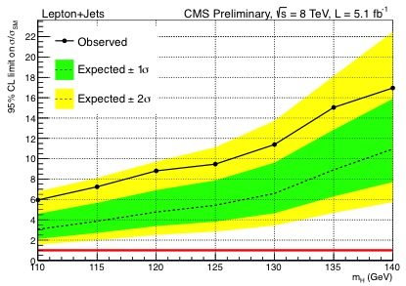
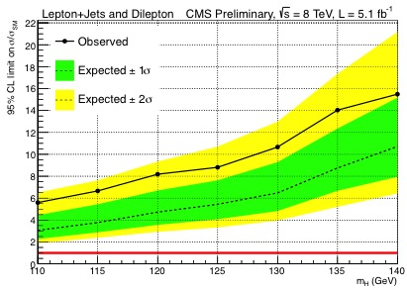
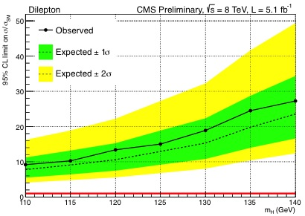
Limit Setting – 8TeV Only
Lepton+Jets
Lepton+Jets and DiLepton
diLepton
Ideally, extract and measure Higgs signal – but no large excess in SM predictions seen
Proceed by setting upper limit on Higgs production
At Higgs mass 125 GeV, Lepton+Jets Channel
expect to set a limit of 5.4x σ_{SM}
observed upper limit: 8.8 x σ_{SM}
John Wood – jgw2kb@virginia.edu – University of Virginia

Slide 43
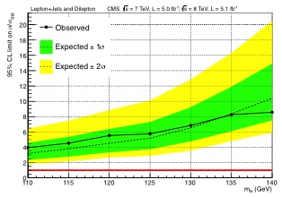
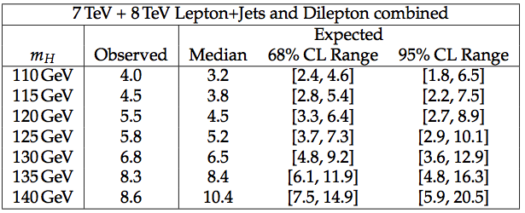
Summary of Initial 7+8TeV Results
A similar analysis also exists for the 7TeV data, with approximately equal statistics
Combine 7+8TeV results to improve sensitivity to ttH production
At M125
Expected limit = 5.2 x σ_{SM}
Observed limit = 5.8 x σ_{SM}
John Wood – jgw2kb@virginia.edu – University of Virginia

Slide 44
Summary of Initial 7+8TeV Results
A similar analysis also exists for the 7TeV data, with approximately equal statistics
Combine 7+8TeV results to improve sensitivity to ttH production
At M125
Expected limit = 5.2 x σ_{SM}
Observed limit = 5.8 x σ_{SM}
Publication – 5 fb⁻¹ 7TeV data, first 5 fb⁻¹ 8TeV data
Lepton+Jets, diLepton Channels
JHEP, May 2013, JHEP paper link
Arxiv: http://arxiv.org/pdf/1303.0763v1.pdf
John Wood – jgw2kb@virginia.edu – University of Virginia

Slide 45
2nd Publication, 19.5 fb⁻¹ 8 TeV
Update to Full 19.5 fb⁻¹ of 8TeV data
Improved data statistics – x4 stats wrt 2011
Higher statistics Monte Carlo
Derived custom b-tag Scale Factors
Improved MVA structure, input variables
Additional Search Channels for Combination
ttH, H->ττ
ttH, H->WW,ZZ, τ’s-> 3, 4, leptons
ttH, H->ZZ -> Same-sign diLepton
ttH, H->γγ
Public PAS Hig-13-019
Publication – 5 fb⁻¹ 7TeV data, 19.5 fb⁻¹ 8TeV data
JHEP, September 2014, JHEP paper link
Arxiv: http://arxiv.org/pdf/1408.1682v1.pdf
For the rest of the talk
Updated Lepton+Jets analysis in the H->bb decay mode – full 8TeV data
Initial ttH combined channel results
John Wood – jgw2kb@virginia.edu – University of Virginia

Slide 46
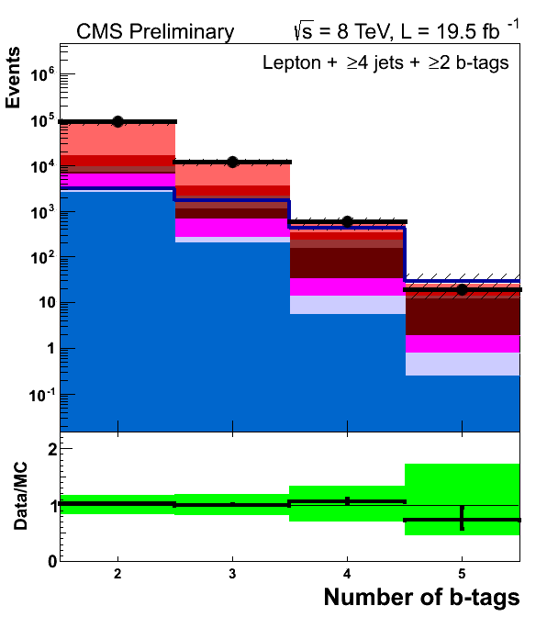
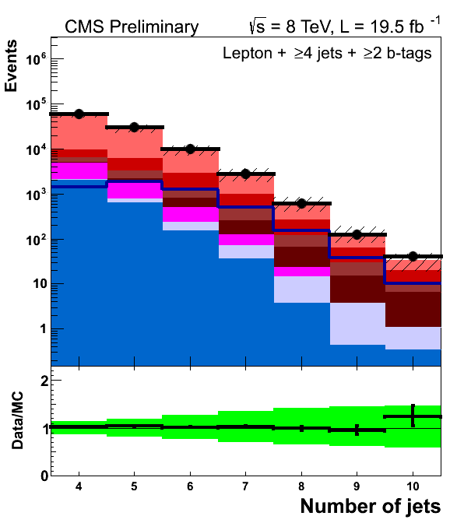
Number of Jets/Tags Distributions
Lepton+Jets, 7 categories:
4 jets (3, ≥ 4 tags)
5 jets (3, ≥ 4 tags)
>=6 jets (2, 3, ≥ 4 tags)
5.1 fb⁻¹
19.5 fb⁻¹
John Wood – jgw2kb@virginia.edu – University of Virginia

Slide 47
Number of Jets/Tags Distributions
Lepton+Jets, 7 categories:
4 jets (3, ≥ 4 tags)
5 jets (3, ≥ 4 tags)
>=6 jets (2, 3, ≥ 4 tags)
5.1 fb⁻¹
19.5 fb⁻¹
John Wood – jgw2kb@virginia.edu – University of Virginia

Slide 48
Signal Extraction – LJ, 8TeV
Ideally, extract and measure Higgs signal – but no large excess in SM predictions seen
Proceed by setting upper limit on Higgs production
At Higgs mass 125 GeV
Expected limit: 4.7xσ_{SM}
Observed limit: 4.9xσ_{SM}
ttH injected: 6.0xσ_{SM}
Compared to 5fb⁻¹ 8 TeV
Expected limit: 5.4xσ_{SM}
Observed limit: 8.8σ_{SM}
Improvement less than expected from increasing lumi alone due to a different and more conservative estimate of systematic uncertainties
John Wood – jgw2kb@virginia.edu – University of Virginia

Slide 49
Summary of Initial 7+8TeV Results
Several Analysis Groups contribute to ttH searches at CMS
Can access all decay modes with one production mechanism!
ttH, H->bb, L+J
ttH, H->bb, diLepton
ttH, H->ττ
ttH, H->γγ
ttH, H->WW,ZZ, τ’s-> 4 Leptons
ttH, H->WW,ZZ, τ’s-> 3 Leptons
ttH, H->ZZ -> Same-Sign dilepton
At M125.7
Expected: 1.8x σ_{SM}
Observed: 4.3x σ_{SM}
Signal Injected: 2.9x σ_{SM}
John Wood – jgw2kb@virginia.edu – University of Virginia

Slide 50
Summary of Initial 7+8TeV Results
Measurement of coupling constant to fermions (k_{f}), and bosons (k_{V})
SM is red/yellow diamond at (1,1)
Solid line is 68% CL, Dashed Line is 95%
John Wood – jgw2kb@virginia.edu – University of Virginia

Slide 51
Looking towards Run 2
This analysis will continue towards its goal of observing the Higgs produced in association with top-quark pairs during the next run of data collection at the LHC
Additional improvements to the analysis are also underway
Investigations into NLO Monte Carlo
NLO tt+0/1/2 jets aMC@NLO + Pythia8, Powheg
NLO tt+bb aMC@NLO + Pythia, Powheg, Sherpa
NLO ttH+0/1 jets aMC@NLO + Pythia8, Powheg
Improved theoretical cross section measurements
Theoretical uncertainty on tt+jets cross section is one of the largest uncertainties for background normalization in >=6Jets >=4tags
Improved jet association algorithms
Correctly identifying which jets came from ttbar versus Higgs system will improve kinematic handle on ttH events
Exploitation of spin correlated variables of decay products
Improved X² minimization, BDT driven algorithm
Optimized BDT techniques
Tiered BDT ie MVA discriminant for each major tt+X background
John Wood – jgw2kb@virginia.edu – University of Virginia

Slide 52
Summary
This analysis is closing in on SM Higgs sensitivity!
Adding in full 8TeV data, 20 fb⁻¹ (x4 more data), plus different set of decay modes has given greater sensitivity to ttH production
Expected limit of the combination at ~1.8 * SM production sensitivity
A measurement of the top-Higgs coupling is essential for the Run2 program at the LHC
Exciting results are coming!!!
John Wood – jgw2kb@virginia.edu – University of Virginia

Slide 53
BACKUP
John Wood – jgw2kb@virginia.edu – University of Virginia

Slide 54
CMS Detector Overview
CMS detector sub-systems
Tracker
66 (9.3) million channels in silicon pixels (strips) – high precision detection of ionizing radiation from charged particles
ECAL
60k(14k) PbWO₄ crystals -Absorbing/Scintillating medium from electromagnetic particles – e⁻ and γ deposit the most
HCAL
17 layers of plastic scintillator interspaced in brass (steel for outer/innermost layers) absorbers-initiates cascade & samples energy
Muon System
3 types of detectors- DTs, CSCs, RPCs, each specializing for use in tracking, spatial, and timing resolution
John Wood – jgw2kb@virginia.edu – University of Virginia

Slide 55
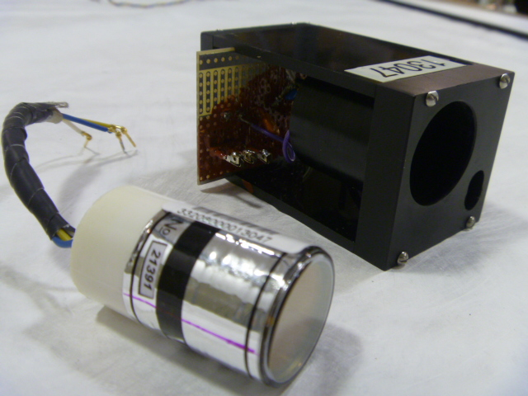
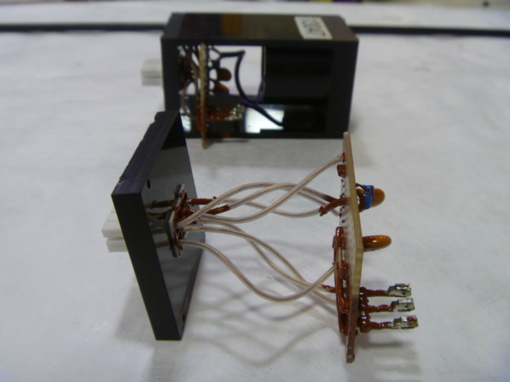
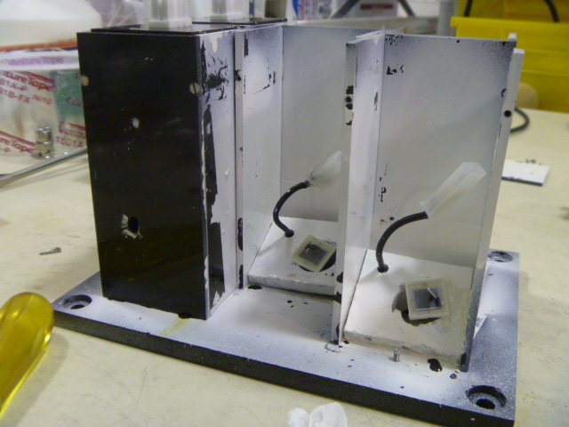
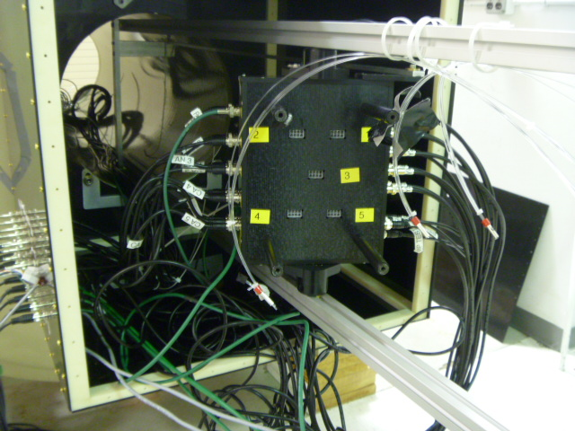
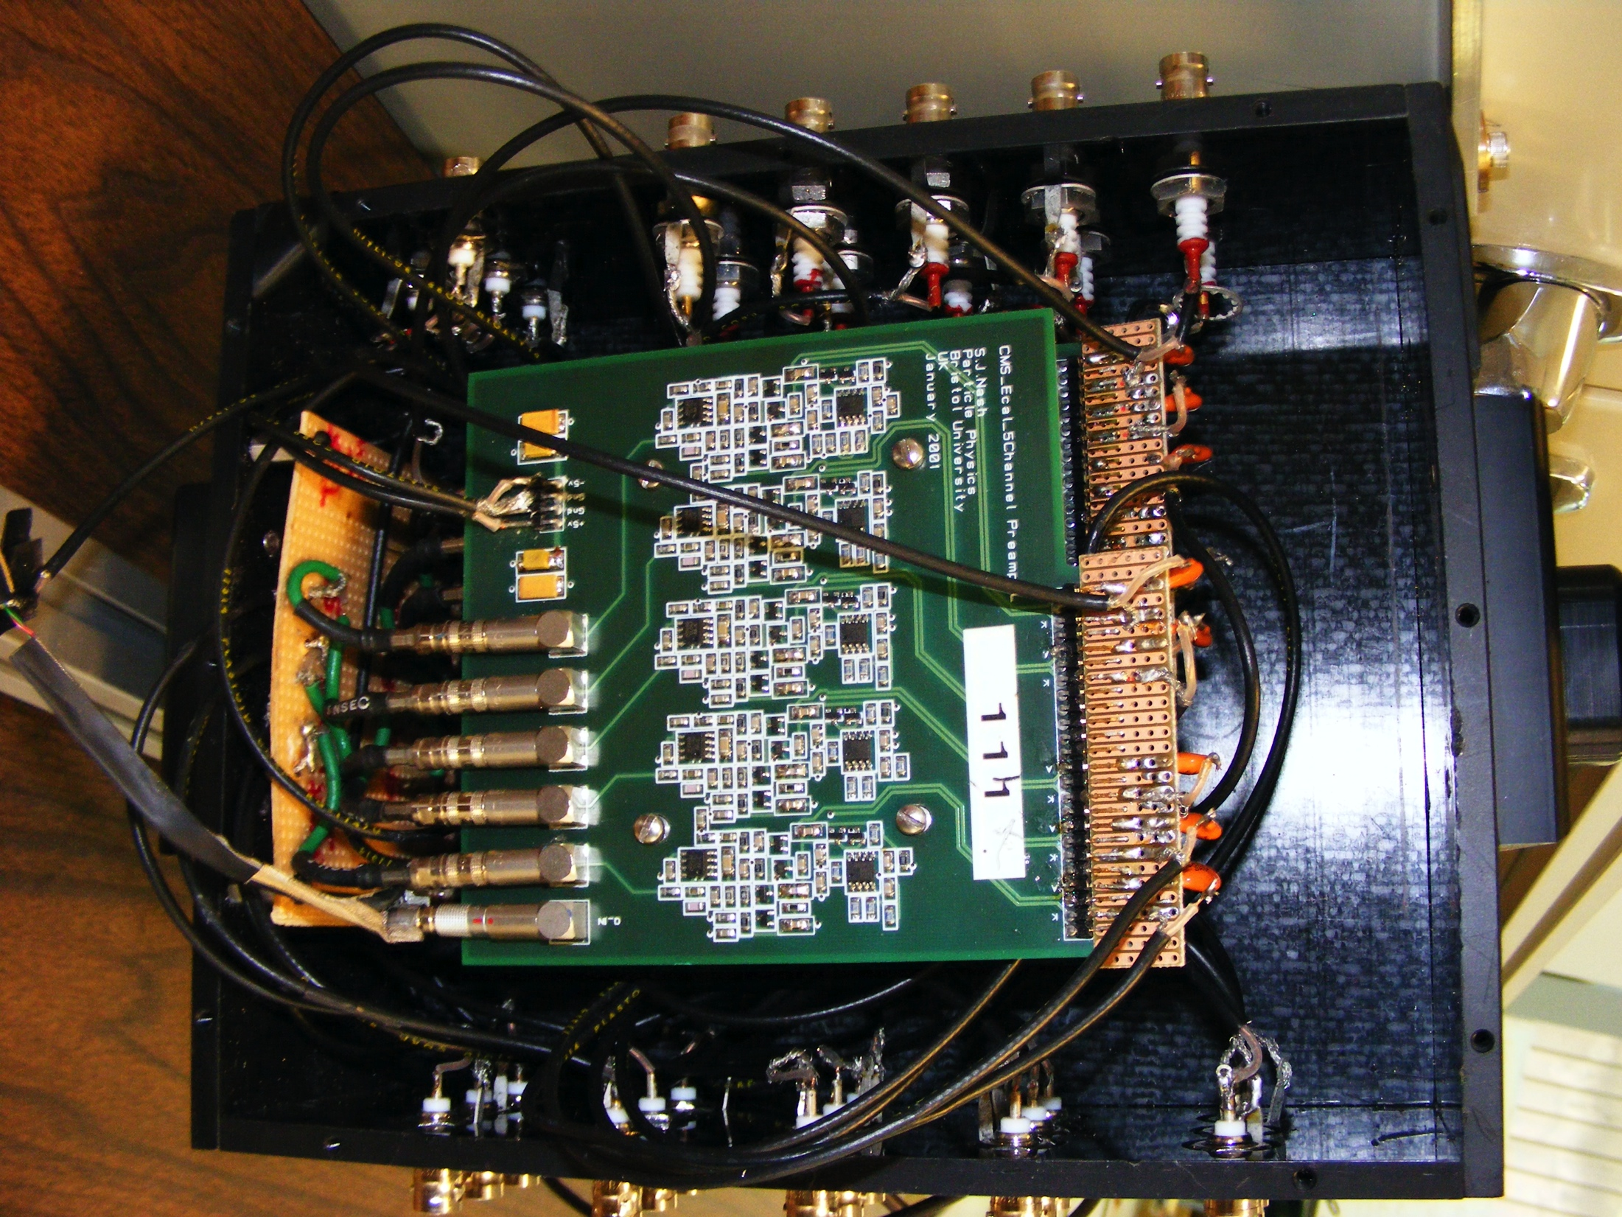
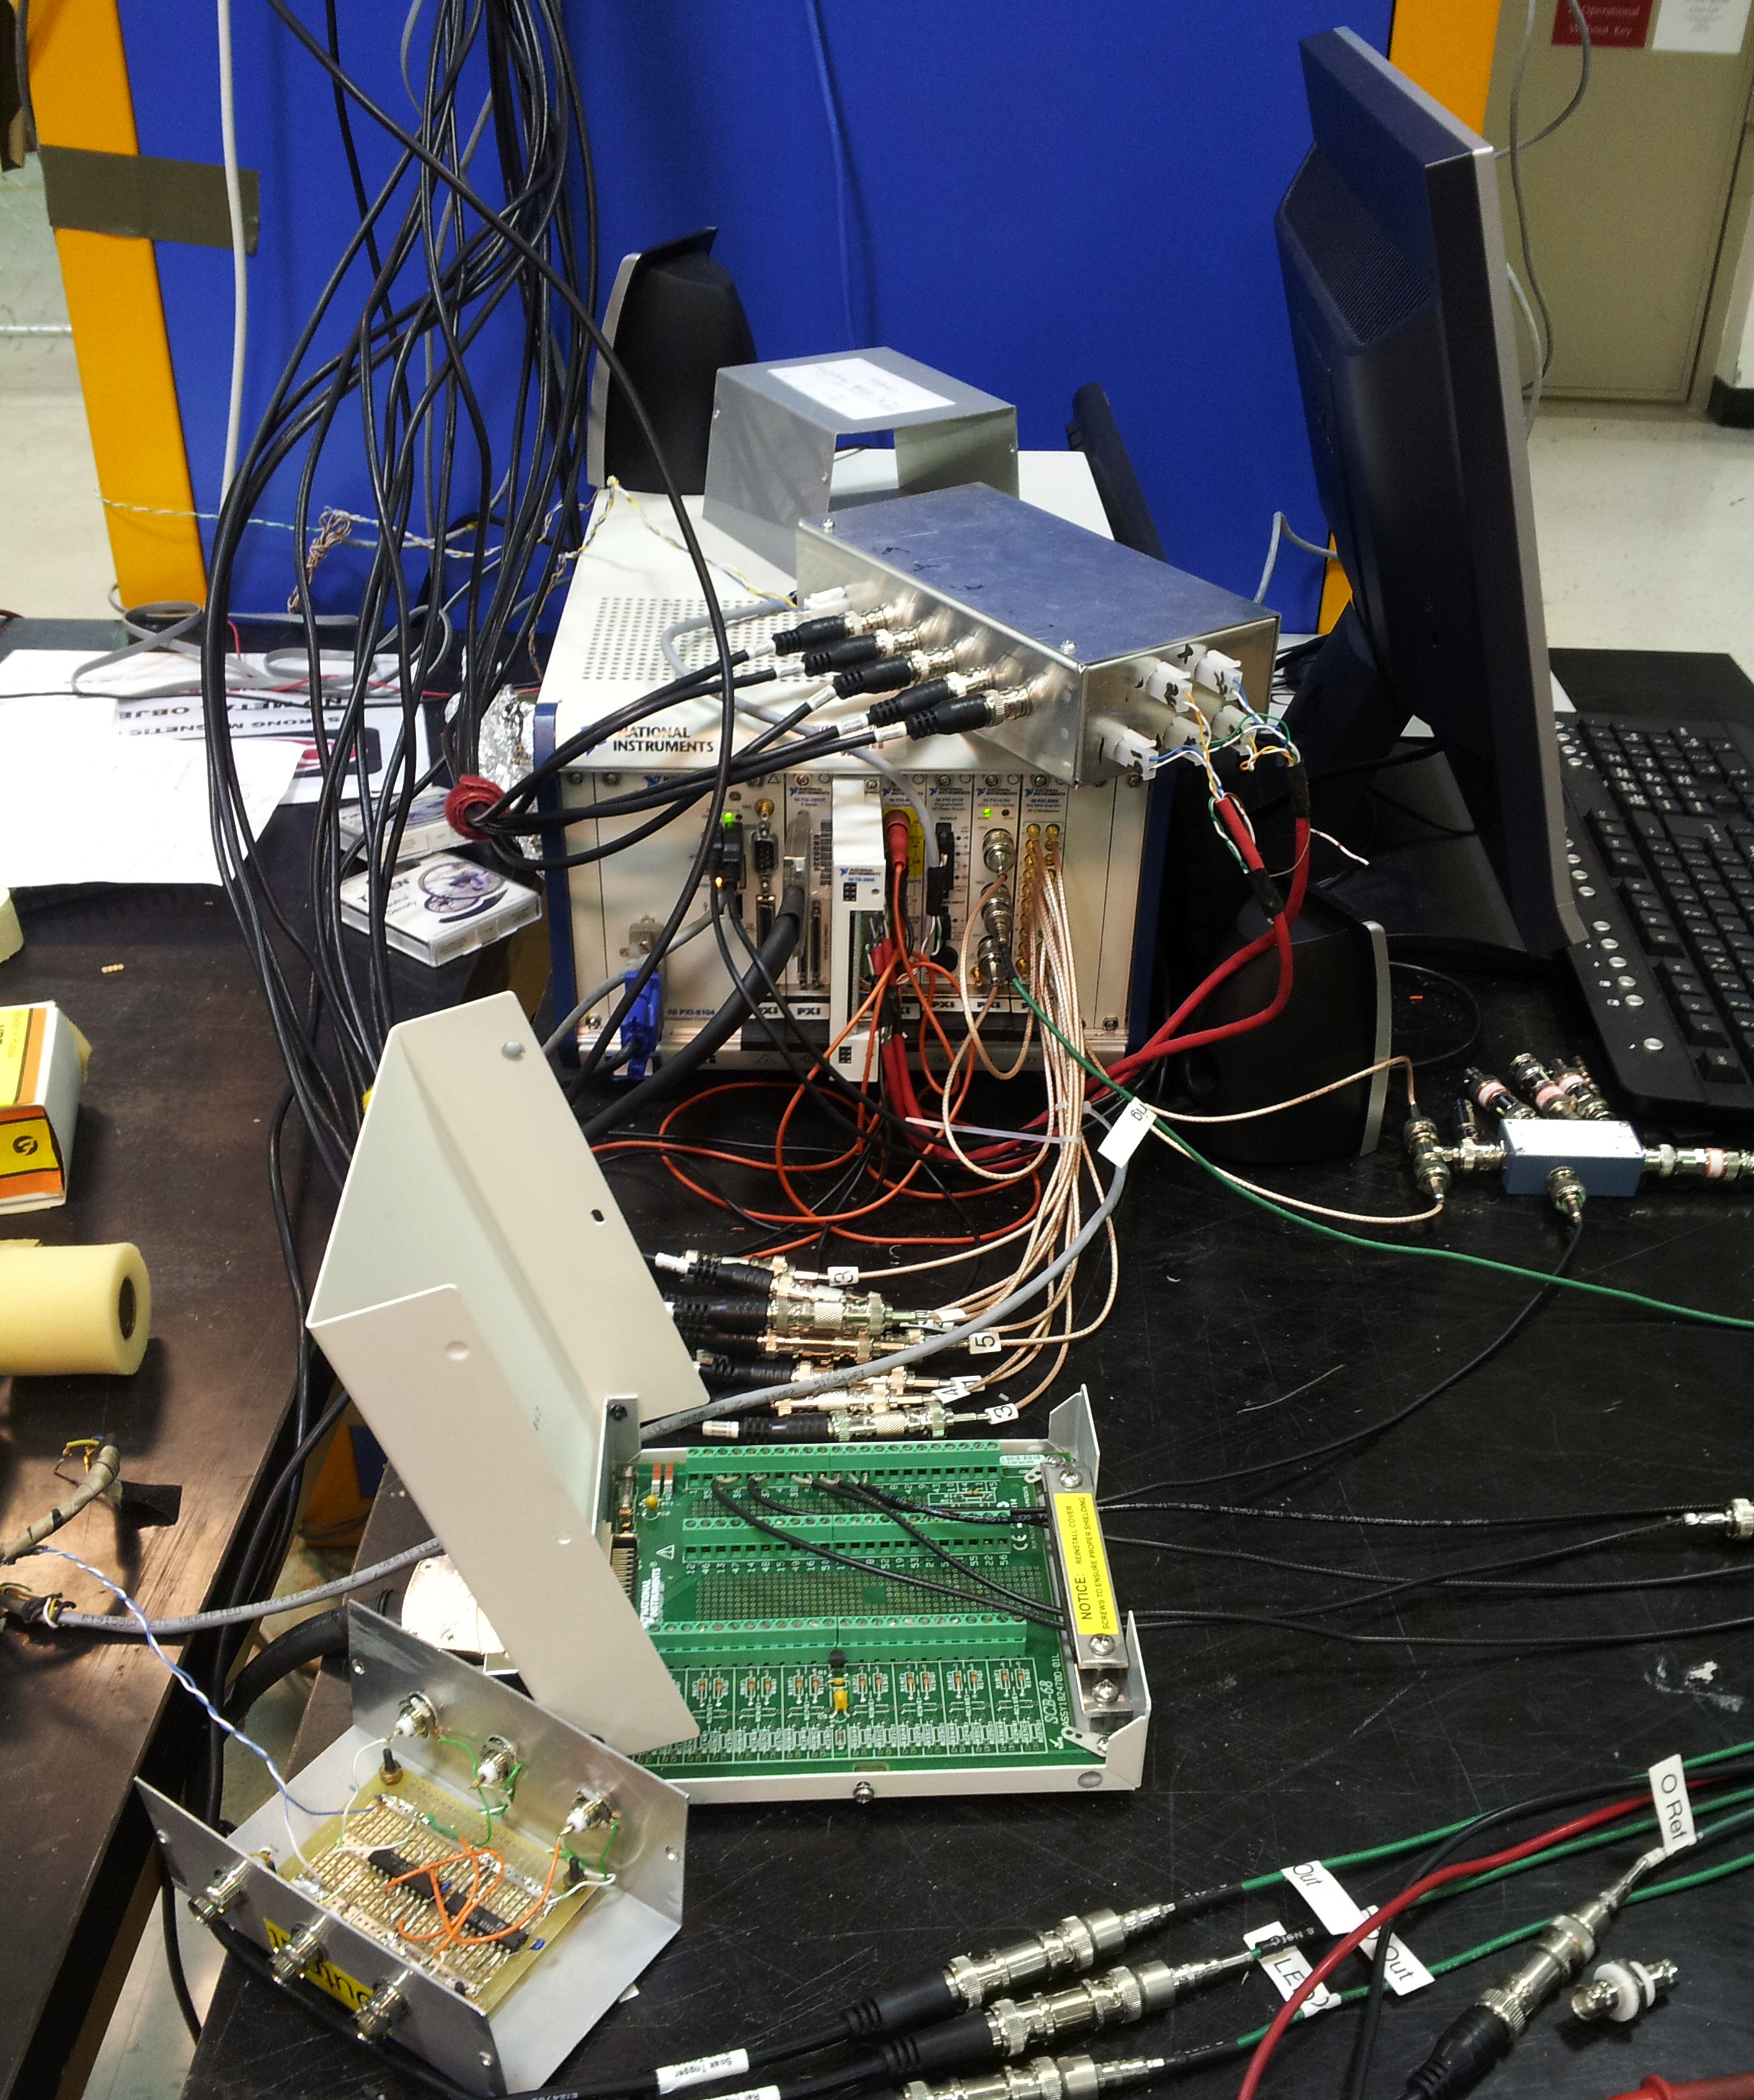
VPT Rig
Connection Scheme
VPT & Housing
Simple HV filtering
Array of vpt & PIN chambers
Connection of chambers to amplifier
Amplifier Housing
NI PXI crate, DAQ for automated measurements
John Wood, University of Virginia jgw2kb@virginia.edu

Slide 56
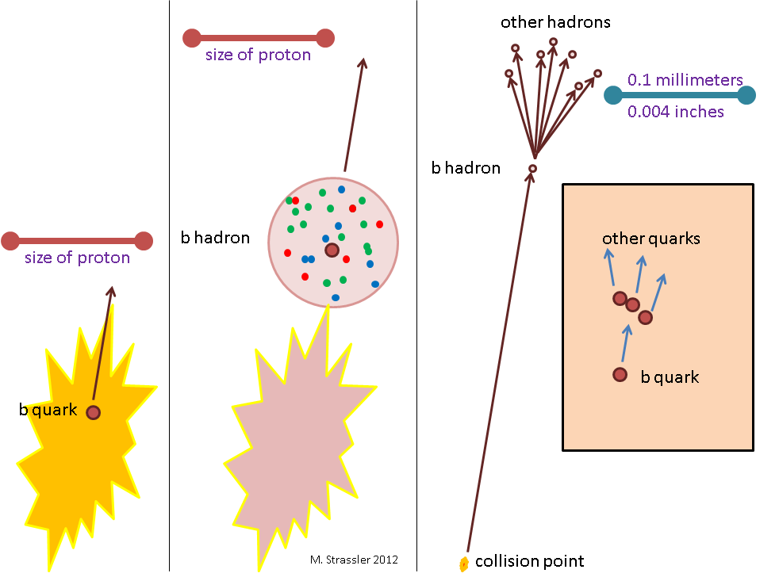
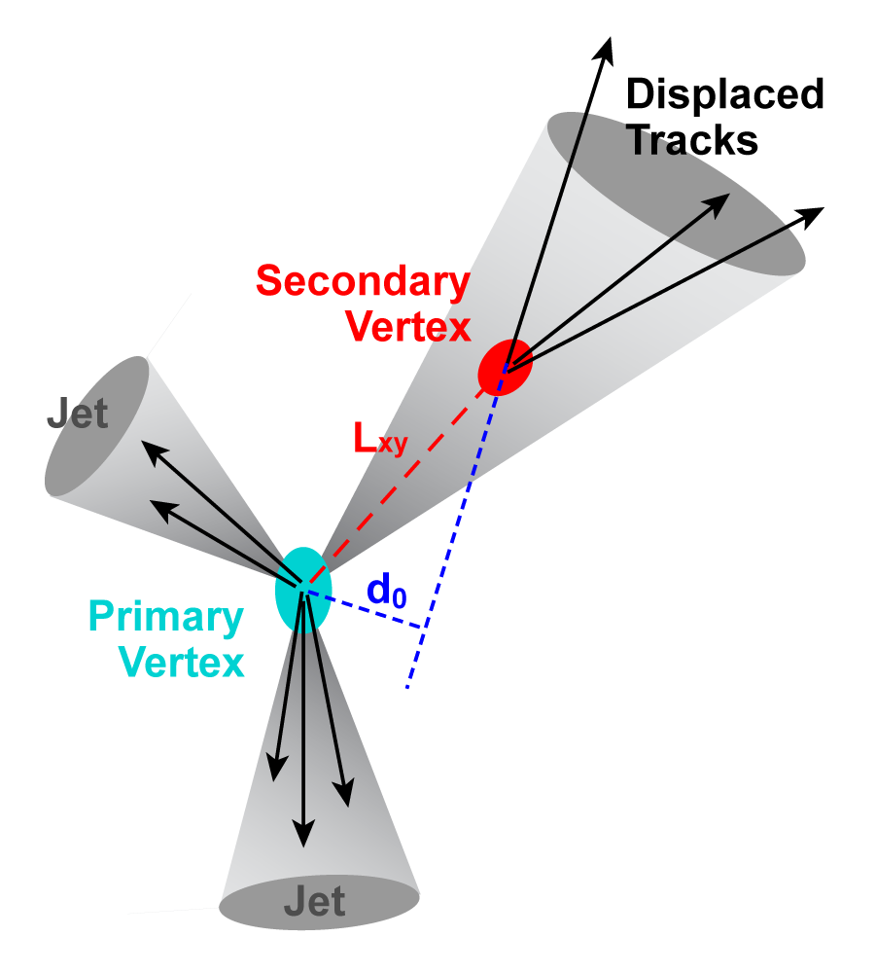
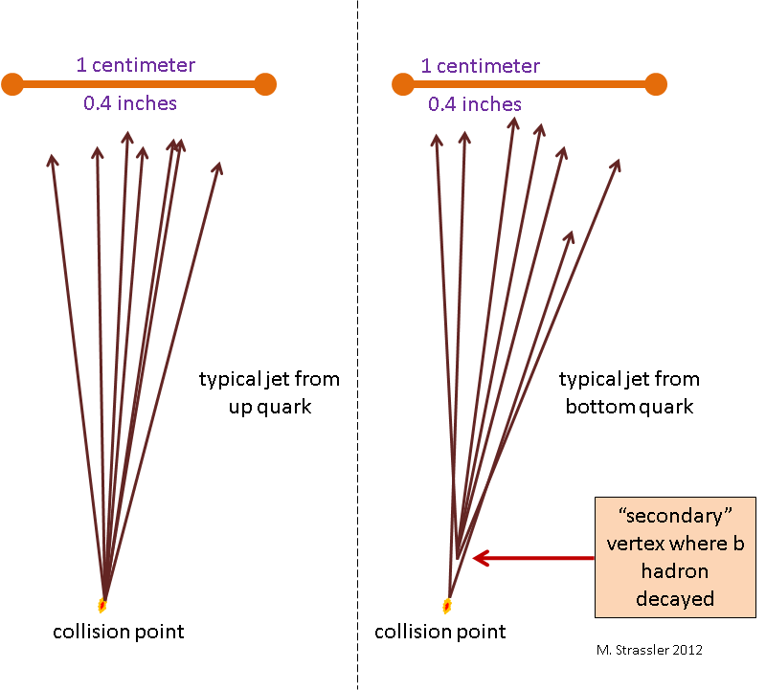
b-Tagging
CKM matrix has top->bottom quark at 99.9%
b-quarks have low probability of decaying to other quarks, on average, longer decays
Macroscopically observable time of flight - observe a displaced secondary vertex
Several algorithms available to attempt to “tag”, a jet as being from a b-quark
Very important for ID of top-quarks, due to high CKM mixing probability
John Wood – jgw2kb@virginia.edu – University of Virginia

Slide 57
b-Tagging
Combined Secondary Vertex (CSV) is our chosen algorithm. MVA with input variables:
invariant mass of 2nd vertex
jet multiplicity
significance of 2nd vertex distance to primary
ratio of energies of 1st/2nd vertex
rapidities of particles associated with 2nd vertex
track impact significance of first track exceeding charm threshold (1.5GeV)
John Wood – jgw2kb@virginia.edu – University of Virginia

Slide 58
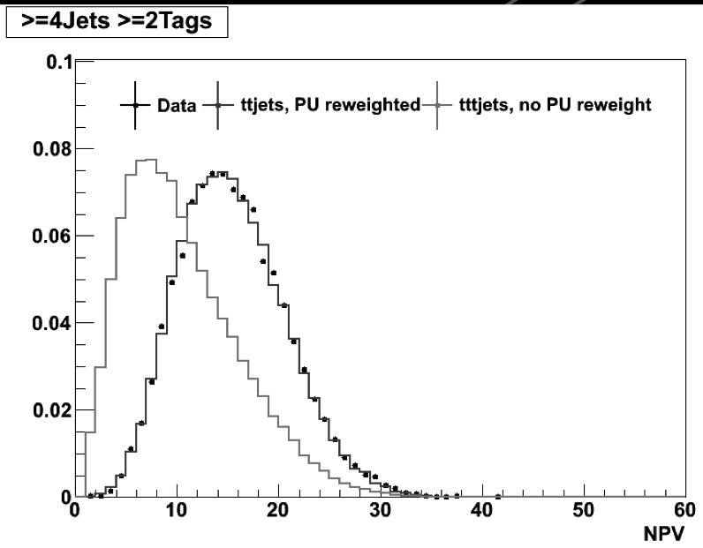
Pileup Reweighting – 5 fb⁻¹ 8 TeV
Left – Distribution of Number of Primary Vertices for each event for tt+jets enriched sample
Red – Monte Carlo is generated with a different pileup profile than data, so events are re-weighted using a sample of min-bias events from data
Blue – Reweighted monte carlo sample of tt+jets enriched events
Black – Data from a sample of tt+jets enriched events
John Wood – jgw2kb@virginia.edu – University of Virginia

Slide 59
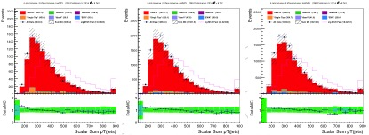
Additional Pileup Reweighting – 5 fb⁻¹ 8 TeV
Scalar Sum of all Jets in the event (Ht) – for different pileup binnings
After PF2PAT overlap removal, charged hadron subtraction, and jet energy corrections are applied, distinct trend in discrepancy between data and monte carlo remains
Correction based on >=4Jets, >=2Tags, Lepton+Jets data and monte carlo comparison
Bin-by-bin correction factor in each of the three pileup bins
NPV<=10
11<=NPV<=15
16<=NPV
John Wood – jgw2kb@virginia.edu – University of Virginia

Slide 60
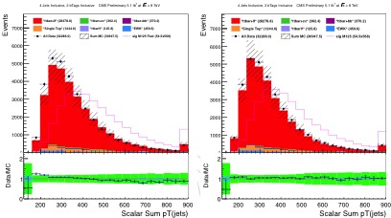
Additional Pileup Reweighting – 5 fb⁻¹ 8 TeV
Below: Left – before Ht correction; Right – after Ht correction
Correction factors derived with variable binning for sufficient stats in tail region, so plot on bottom right is not exactly flat
S/B is 0.002, so no worry of signal bias
Additional systematic uncertainty for given by no corrections and x2 correction factor
John Wood – jgw2kb@virginia.edu – University of Virginia

Slide 61
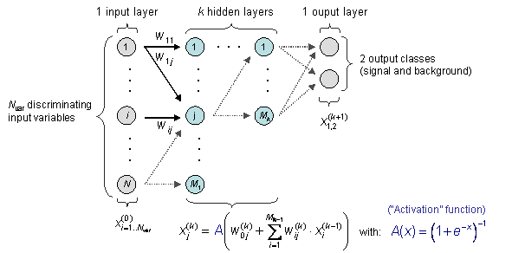
Multi-Variate Analysis Techniques
Artificial Neural Network (ANN) – specific implementation of an MVA. Ours uses 10 input variables, and two hidden layers with 10, 9 nodes respectively
Training events are given to the ANN from a known signal and background source, ANN output is compared to desired result (0=background, 1=signal) and adjusts weights to try and maximize output towards signal/background-like response
John Wood – jgw2kb@virginia.edu – University of Virginia

Slide 62
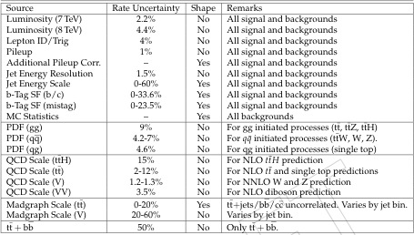
Systematic Uncertainties - Lumi
Below: Table of complete list of uncertainties, % change to normalization, and whether or not uncertainty is used in shape comparison
Luminosity is calculated by using the inner pixel detector
7e7 pixels used
Low occupancy per bunch crossing, one pixel for one track
# of pixels is linearly related to # of interactions per bunch crosses
Sources of uncertainty
Physical distribution of pixel clusters
Resolution on interaction region (length scale calibration)
Uncertainties on Beam characteristics
Width Evolution
BetaStar
Scan-to-Scan uncertainties
Afterglow
John Wood – jgw2kb@virginia.edu – University of Virginia

Slide 63
Systematic Uncertainties – Lepton ID
Lepton ID/Trigger Efficiency uncertainty
Tag & Probe Method
Select two electrons/muons in an invariant mass window around Z peak
Choose events where one electron/muon passes trigger and ID cuts, this is the “tag”
Assume partner is identical (since both should be coming form Z decay)
Check is partner passes trigger/ID, this is “probe”
Efficiency = #probe/#tag which pass trigger ID selection
Sources of uncertainty
Purity of sample
Statistical uncertainty
Below: Table of complete list of uncertainties, % change to normalization, and whether or not uncertainty is used in shape comparison
John Wood – jgw2kb@virginia.edu – University of Virginia

Slide 64
Systematic Uncertainties – Pileup
Pileup is the effect of having multiple interaction points per bunch crossing
MC is generated with an arbitrary number of pileup events
Has to be adjusted to match data distribution
Use control region in data from your HLT to get pileup distribution from data
Scale MC to match
Sources of uncertainty
Min bias Xsection
Number of actual pileup of events in each measurement
Below: Table of complete list of uncertainties, % change to normalization, and whether or not uncertainty is used in shape comparison
John Wood – jgw2kb@virginia.edu – University of Virginia

Slide 65
Systematic Uncertainties – Add. Pileup
Below: Table of complete list of uncertainties, % change to normalization, and whether or not uncertainty is used in shape comparison
Jet pT distributions showed a sloped bias in the data to MC distributions which varied over Number of Primary Vertex (NPV) regions
Use Scalar Sum of all jet pTs in event, Ht
In inclusive selection, reweight this distribution to match data
Weights distributed to jet/tag categories
Yields normalized to # of events before this reweighting
Uncertainty comes from applying no correction to applying x2 the correction
John Wood – jgw2kb@virginia.edu – University of Virginia

Slide 66
Systematic Uncertainties – JER
Below: Table of complete list of uncertainties, % change to normalization, and whether or not uncertainty is used in shape comparison
Jet Energy Resolution (JER) is different between MC and data
Need a scale factor for jet 4-vector, to “smear” resolution of jet energy and momentum in MC to match data
Photon+Jet, Z+Jet, and diJet events are used to study energy resolution in pT, eta, phi bins in the detector
Uncertainty comes from
Purity of sample
Uncertainty on invariant mass fits in resolution analysis
John Wood – jgw2kb@virginia.edu – University of Virginia

Slide 67
Systematic Uncertainties – JES
Jet Energy Scale corrections are based on corrections made to jet energies during reconstruction
Energy offset (L1 correction) is performed to remove energy from pileup deposits
Eta correction (L2 correction) performed to ensure uniform detector response in eta
Pt correction (L3 correction) performed to ensure uniform detector response from kinematically similar events
Corrections derived by studying Z-jetjet using tag & probe, and other diJet processes
Uncertainty determined by varying Jet Energy Scale correction factors +/- 1 sigma and reproducing ANN output shapes
Below: Table of complete list of uncertainties, % change to normalization, and whether or not uncertainty is used in shape comparison
John Wood – jgw2kb@virginia.edu – University of Virginia

Slide 68
Systematic Uncertainties – bTag hfSF
Begin with high purity sample of bQuarks
Muon-Jet method, multi-jet production
Strong mixing to top-quark gives larger semi-leptonic BR vs other quarks
Look for jets with a muon within deltaR<0.4
Alternative use high-purity ttbar sample, but we need those events in our analysis
Several methods to determine efficiency
“System8”, tag & probe style method, ID a muon-jet as probe, use jet passing some number of alt. tagging algos
Measure efficiency in data to be ~70%, need MC to match this
Uncertainties due to purity of sample, pileup, gluon splitting, muon ID, bias of other tagger
Below: Table of complete list of uncertainties, % change to normalization, and whether or not uncertainty is used in shape comparison
John Wood – jgw2kb@virginia.edu – University of Virginia

Slide 69
Systematic Uncertainties – bTag lfSF
Similar procedure to calculate mis-ID SF uncertainty, ie uncertainty on SF for lf jets tagged as b-Jets
Invert away-jet tagger cut, still probe with muon jet
Systematic uncertainties
b/c quark fractions
Gluon fractions
Long-lived meson decays
Mis-ID on tracks
Pileup
Purity of sample
Vary results of SF due to these different uncertainties, get +/- 1 sigma on SF, recreate ANN distributions
Probability to mis-ID lf jet as b for CSVM ~1.5%
Below: Table of complete list of uncertainties, % change to normalization, and whether or not uncertainty is used in shape comparison
John Wood – jgw2kb@virginia.edu – University of Virginia

Slide 70
Systematic Uncertainties – PDF
Below: Table of complete list of uncertainties, % change to normalization, and whether or not uncertainty is used in shape comparison
Uncertainty from knowledge on initial Parton Distribution Function of protons being collided
Studied from earlier Tevatron, and earlier runs at CMS’ knowledge of the proton
Initial state energies of particles are essentially varied, giving different rates for background processes
Adjust rates +/- 1 sigma from quoted uncertainty used across CMS
John Wood – jgw2kb@virginia.edu – University of Virginia

Slide 71
Systematic Uncertainties – QCD Scale
Below: Table of complete list of uncertainties, % change to normalization, and whether or not uncertainty is used in shape comparison
Theoretical uncertainties on production cross-sections from theory
Estimated by considering effects of next order in perturbation theory on results from current level of calculation
Processes Effected:
ttH (signal)
tt+lf,c,b
V+X events
VV+X events
John Wood – jgw2kb@virginia.edu – University of Virginia

Slide 72
Systematic Uncertainties – Q²
Q^2 is the factorization and renormalization uncertainties from using MC
Uncertainty from not matching data exactly, thus energy scale, ie strength of coupling constants, kinematic distributions from decays are all affected
Vary Q^2 in the initial MC samples, reproduce ANN output distribution to have rate and shape information about how ANN should change due to this effect
Below: Table of complete list of uncertainties, % change to normalization, and whether or not uncertainty is used in shape comparison
John Wood – jgw2kb@virginia.edu – University of Virginia

Slide 73
Systematic Uncertainties – tt+bb
Below: Table of complete list of uncertainties, % change to normalization, and whether or not uncertainty is used in shape comparison
Since the tt+bb background is kinematically very similar to our signal, it is hard to discriminate against
In order to be conservative in our estimates of ttH production, we added an additional 50% uncertainty on top of the existing cross-section uncertainty
John Wood – jgw2kb@virginia.edu – University of Virginia

Slide 74
Limit Setting Technique
In the case of no clear signal, ask what is the upper limit on ttH production possible that can still be explained by this dataset
CLs is modified frequentist technique (~Bayesian, relies on background prediction)
Templates for signal and background processes, nominal and +/- 1σ for shape uncertainties
Perform pseudoexperiments - vary template shapes within constraints of systematics
Test signal+background and background only hypothesis by performing a fit across each jet/tag category simultaneously
Signal-poor categories constrain background fit in signal-rich jet/tag categories
Repeat many times to get distribution of +/- 1,2σ uncertainty bands
John Wood – jgw2kb@virginia.edu – University of Virginia

Slide 75
tt+bb vs tt+lf discriminant– 8TeV L+J, mu+ele
In order to gauge the sensitivity of our analysis to tt+bb, we have trained an ANN to discriminate tt+bb from tt+lf
Using CFMlpANN MVA – same type of MVA algorithm used in signal extraction
Train tt+bb as signal against tt+lf background
Divide samples into 2 sub-categories, so that TMVA has sufficient events in each sample to train the ANN
==5 Jets, >=3 bTags
>=6 Jets, >=3 bTags
For comparison, have also created plots with the X-Section for tt+bb doubled
From these we can look for any discrepancies between data and MC agreement, which could possibly be attributed to erroneous assumptions on the XS or shape of the tt+bb process
John Wood – jgw2kb@virginia.edu – University of Virginia

Slide 76
tt+bb vs tt+lf discriminant– 8TeV L+J, mu+ele, >=5J >=3T
For the inclusive category, Nominal tt+bb XS accounts for data within error bands
Doubling tt+bb XS improves agreement only slightly
Nominal tt+bb
x2 tt+bb XS
John Wood – jgw2kb@virginia.edu – University of Virginia

Slide 77
tt+bb vs tt+lf discriminant– 8TeV L+J, mu+ele, ==5J, >=3T
Nominal tt+bb XS accounts for data within error bands
In this sub-category, doubling tt+bb XS improves only a few bins
Nominal tt+bb
x2 tt+bb XS
John Wood – jgw2kb@virginia.edu – University of Virginia

Slide 78
tt+bb vs tt+lf discriminant– 8TeV L+J, mu+ele, >=6J, >=3T
Here, in the most sensitive category for tt+bb, nominal tt+bb XS shows more consistent levels of agreement than the doubled XS
Nominal tt+bb
x2 tt+bb XS
John Wood – jgw2kb@virginia.edu – University of Virginia

Slide 79
tt+bb vs tt+lf discriminant– 8TeV L+J, mu+ele, ==5J, >=3T
Looking at the region with best tt+bb/Sum_allBg, doubling XS provides some improvement
Nominal tt+bb
x2 tt+bb XS
John Wood – jgw2kb@virginia.edu – University of Virginia

Slide 80
tt+bb vs tt+lf discriminant– 8TeV L+J, mu+ele, >=6J, >=3T
In this category, which has the best tt+bb/allBg ratio; in the most sensitive region of this discriminant: nominal tt+bb XS provides better agreement
Nominal tt+bb
x2 tt+bb XS
John Wood – jgw2kb@virginia.edu – University of Virginia

Slide 81
tt+bb vs tt+lf discriminant– 8TeV L+J, mu+ele
Cutflow tables for nominal, and x2 tt+bb XS cases
Nominal tt+bb
x2 tt+bb XS
John Wood – jgw2kb@virginia.edu – University of Virginia

Slide 82
tt+bb vs tt+lf discriminant– 8TeV 5fb⁻¹ L+J, mu+ele
==5 Jets, >=3 bTags
This category shows some improvement overall when doubling the tt+bb XS
>=6 Jets, >=3 bTags
This category only shows slight improvement overall when doubling tt+bb XS
In the most sensitive region of the discriminant for tt+bb, the nominal XS showed shows the better agreement
By designing an MVA to look specifically for tt+bb, we can gauge how accurately we believe we are modeling this process
It is not clear that increasing the tt+bb X-section is the right thing to do for all categories. Hence, we propose to increase our systematic uncertainty on the normalization of this process to a larger number, 100%
Also, even though we look at these plots and can make statements about the yields/shapes for these different scenarios, there is no statistically significant discrepancy in any of the nominal shapes. The size of the tt+bb “signal” is approximately the same size as the uncertainty of the background (which is driven by tt+lf)
John Wood – jgw2kb@virginia.edu – University of Virginia

Slide 83
Pre/Post Fit Comparison – 8 TeV 5 fb⁻¹
Pre-fit versus post-fit normalizations for all backgrounds and signal
In general, background uncertainties reduced, signal uncertainty increased
K-Factor for tt+bb consistent with expectations from NLO comparisons
John Wood – jgw2kb@virginia.edu – University of Virginia

Slide 84
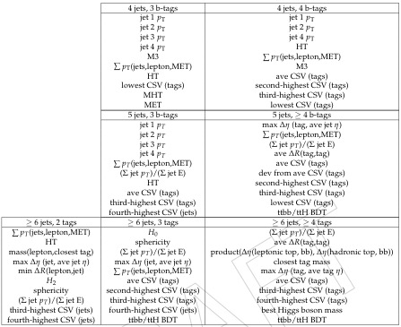
Input Variables, all Categories
Above: Variables used for the ttbb/ttH discriminant in the most signal sensitive categories
Right: Variables used for tt+Jets/ttH discriminant used in signal extraction and limit setting
John Wood – jgw2kb@virginia.edu – University of Virginia

Slide 85
Boosted Decision Tree - Input
Train BDT, 10 variables depending on category (eg. ==5j, ==3t, signal scaled x 30):
Sum of pT for lepton, jets, MET
avg b-tag discriminant value (CSV) for tagged jets
Scalar Sum of pT, Jets (Ht)
Third highest b-tag CSV
Fourth highest CSV
Highest pT jet
Second highest pT jet
Third Highest pT jet
Fourth highest pT jet
Sum of Jet pT / Sum of jet Energy
John Wood – jgw2kb@virginia.edu – University of Virginia

Slide 86
Boosted Decision Tree - Input
Train BDT, 10 variables depending on category (eg. ==5j, ==3t, signal scaled x 30 ):
Sum of pT for lepton, jets, MET
avg b-tag discriminant value (CSV) for tagged jets
Scalar Sum of pT, Jets (Ht)
Third highest b-tag CSV
Fourth highest CSV
Highest pT jet
Second highest pT jet
Third Highest pT jet
Fourth highest pT jet
Sum of Jet pT / Sum of jet Energy
John Wood – jgw2kb@virginia.edu – University of Virginia

Slide 87
Boosted Decision Tree – Output
Events which are more similar to largest background, tt+jets, have values closer to -1, events which are most similar to ttH, have values closer to 1
Example to the right is from the Lepton+Jets analysis: (==5Jets,==3Tags)
John Wood – jgw2kb@virginia.edu – University of Virginia

Slide 88
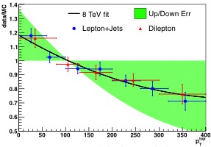
Top pT Reweighting – 19.5 fb⁻¹ 8 TeV
New Monte Carlo ttJets samples also exhibited the same discrepancy with respect to data that we previously used Ht reweighting to correct
Top pT cross section measured in data and compared to madgraph monte carlo
Top pT at genParton level is softer than data at low pT, so correction factor and associated systematic uncertainty added to the analysis
John Wood – jgw2kb@virginia.edu – University of Virginia

Slide 89
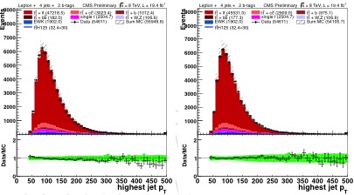
Top pT Reweighting – 19.5 fb⁻¹ 8 TeV
>=4Jets >=2Tags Data to Monte Comparison before (left) and after (right) top pT reweighting
Sloped trend clearly reduced, and based off of data-driven measurements
Replaces Ht re-weighting from previous iteration of analysis
John Wood – jgw2kb@virginia.edu – University of Virginia

Slide 90
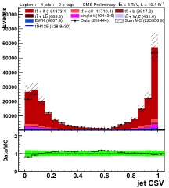
bTag Scale Factors – 19.5 fb⁻¹ 8 TeV
When updating to the full 8 TeV dataset, set discovered a new problem in the modeling of the bTagging discriminant
(Right) Data to MC comparisons of jet csv in the Lepton+Jets ==4Jet ==2Tag channel shows a distinctive “bow” in the csv shape
Since we rely heavily on CSV shape in our signal extraction BDT, it is necessary to model this variable correctly
Data-Driven correction factors
Tag and Probe in tt+jets enriched, 2jet, diLepton sample for efficiency scale factor (HF scale factor)
Tag and Probe in Z+jets enriched, 2 jet, diLepton sample for mistag scale factor (LF scale factor)
Bin in pT and eta for optimal SF extraction
John Wood – jgw2kb@virginia.edu – University of Virginia

Slide 91
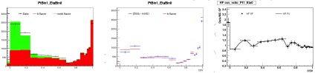
bTag Scale Factors – 19.5 fb⁻¹ 8 TeV
pT bins of [30,40], [40, 60], [60+]
|eta| bins of [0, 0.8], [0.8, 1.6], [1.6, 2.4]
(Above) Light Flavor (Below) Heavy Flavor
(Left) Data vs MC comparisons of LF/HF regions
(Center) Isolating LF/HF in data – subtract HF mc from LF data, and vice versa
(Right) Scale Factors after applying tag & probe technique to selected sample
John Wood – jgw2kb@virginia.edu – University of Virginia

Slide 92
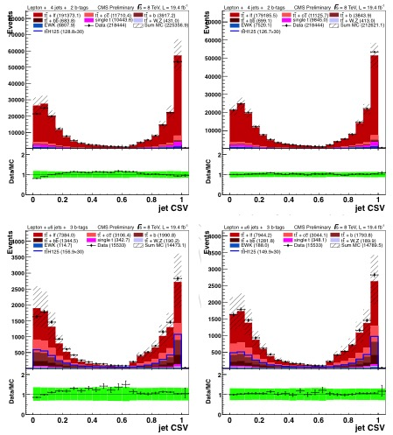
bTag Scale Factors – 19.5 fb⁻¹ 8 TeV
(Above Left) ==4Jets ==2Tags jet csv distribution without scale factors – note distinct bow in center
(Above Right) ==4Jets ==2Tags jet csv distribution with scale factors – flat data/mc ratio shows csv factors derived in diLepton work in lepton+jets
(Below Left) >=6Jets ==2Tags jet csv distribution without scale factors – note distinct bow in center
(Below Right) >=6Jets ==2Tags jet csv distribution with scale factors – flat data/mc ratio shows csv factors derived in diLepton work in lepton+jets in high jet multiplicity environment
John Wood – jgw2kb@virginia.edu – University of Virginia

Slide 93
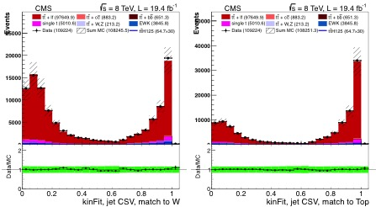
bTag Scale Factors – 19.5 fb⁻¹ 8 TeV
(Below Right) ==4Jets ==2Tags jet csv distribution with scale factors, for selection of jets matched to W boson decays, using a X² minimization algorithm- validating LF Scale Factors
(Below Left) ==4Jets ==2Tags jet csv distribution with scale factors, for selection of jets matched to b-quark decays from top quarks, using a X² minimization algorithm – validating HF scale factors
John Wood – jgw2kb@virginia.edu – University of Virginia

Slide 94
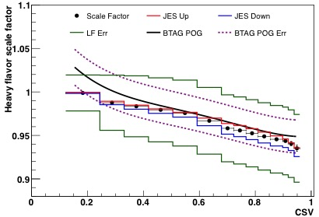
bTag Scale Factors – 19.5 fb⁻¹ 8 TeV
(Right) Comparison of Scale Factors and Uncertainties to bTag POG Scale Factors and uncertainties
Measuring Scale factors in differential form comes at a cost of increased uncertainty bands
Uncertainties based on:
JES Scale Up/Down
Purity Uncertainty from Subtracting MC from data
Statistical uncertainty from using MC
Method described in AN-13-130 and is now an official bTag POG set of scale factors
John Wood – jgw2kb@virginia.edu – University of Virginia

Slide 95
Boosted Decision Tree – Output
John Wood – jgw2kb@virginia.edu – University of Virginia

Slide 96
Systematic Uncertainties
Uncertainties table for sum of ttbar+X background yields
>=6Jet, >=4Tag category
QCD Scale– ie renormalization and factorization uncertainty – MC only uncertainty, due to matrix element nature of calculations, it is the largest uncertainty in the analysis
bTagging efficiencies –differences in tagging efficiencies between data and MC
Other sources – uncertainties on scale of jet energy measurement, momentum distributions of incoming colliding partons, and production rates of SM processes
John Wood – jgw2kb@virginia.edu – University of Virginia

Slide 97
Background Composition Comparison, 6j4t
CMS “Baseline” vs ATLAS results, taken from conference note
Error bars on CMS numbers are from shape systematics only from limit file
Scaled to 20.3 fb⁻¹, ATLAS lumi
tt+bb = tt+ 1,2b
f_{tt+I} = fraction of tt+Inclusive Jets
Pre-fit yields for both experiments
In this category, fractional composition is rather different for ATLAS and CMS, with ATLAS claiming an increase in ttH signal but also tt+bb background
John Wood – jgw2kb@virginia.edu – University of Virginia

Slide 98
Background Composition Comparison, jet/lepPt>25, 6j4t
CMS jet/lep pT>25 vs ATLAS results
Error bars on CMS numbers are from shape systematics only from limit file
Scaled to 20.3 fb⁻¹, ATLAS lumi
tt+bb = tt+ 1,2b
f_{tt+I} = fraction of tt+Inclusive Jets
Pre-fit yields for both experiments
Still less ttH and tt+bb than ATLAS, but closer than in baseline analysis
Fractional composition is ~same as CMS baseline analysis
John Wood – jgw2kb@virginia.edu – University of Virginia

Slide 99
Summary of Analysis Configuration Studies
Right Col., blind, would guide analysis decisions; Center Col., partial unblind, for ATLAS comparison
Scenario | Exp. Limit (“Unblinded”) | Exp Limit (“Blind”, “-t –1”)
Baseline | 4.83 | 3.80
jetLep pT>25, new BDT weights | 4.45 | 3.83
Baseline, add HT var for 4j2t, 5j2t | 4.14 | 3.52
jetLep pT>25, new BDT weights, add HT var for 4j2t, 5j2t | 3.94 | 3.70
Many other options have been tested as well, focusing on background composition and other effects
Scenario | Exp. Limit (“Unblinded”) | Exp Limit (“Blind”, “-t –1”)
tt+lf to ATLAS | -- | 3.58
tt+cc/bb to ATLAS | -- | 3.98
tt+lf/cc/bb to ATLAS | -- | 3.73
ttH, tt+lf/cc/bb to ATLAS | -- | 3.17
ttH, tt+lf/cc/bb to ATLAS, add HT var for 4j2t, 5j2t | -- | 3.02
Baseline, add BDT var for 4j2t, 5j2t | 4.17 | 3.52
jetLep pT>25, new BDT weights, add BDT var for 4j2t, 5j2t | 3.98 | 3.70
John Wood – jgw2kb@virginia.edu – University of Virginia

Slide 100
Summary of Analysis Configuration Studies
Right Col., blind, is all we would have access to when designing the analysis
Scenario | Exp. Limit (“Unblinded”) | Exp Limit (“Blind”, “-t –1”)
Baseline | 4.83 | 3.80
jetLep pT>25, new BDT weights | 4.45 | 3.83
Baseline, add HT var for 4j2t, 5j2t | 4.14 | 3.52
jetLep pT>25, new BDT weights, add HT var for 4j2t, 5j2t | 3.94 | 3.70
Many other options have been tested as well, focusing on background composition and other effects
Scenario | Exp. Limit (“Unblinded”) | Exp Limit (“Blind”, “-t –1”)
tt+lf to ATLAS | -- | 3.58
tt+cc/bb to ATLAS | -- | 3.98
tt+lf/cc/bb to ATLAS | -- | 3.73
ttH, tt+lf/cc/bb to ATLAS | -- | 3.17
ttH, tt+lf/cc/bb to ATLAS, add HT var for 4j2t, 5j2t | -- | 3.02
Baseline, add BDT var for 4j2t, 5j2t | 4.17 | 3.52
jetLep pT>25, new BDT weights, add BDT var for 4j2t, 5j2t | 3.98 | 3.70
John Wood – jgw2kb@virginia.edu – University of Virginia

